Slide 1
Chest Pneumonia Detection
Data Analysis and Machine Learning Using Python Internship
One Man Army
Harshit Gupta

Slide 2
Outline
Dataset Description
Preparing the Data to feed into the Model
Data Visualisation

Slide 3
Dataset Description
5856 X-Ray Images
Train
Test
Validation
Pneumonia
Normal
Normal
Pneumonia
Normal
Pneumonia
234
390
1341
3875
8
8
J. Melendez, G. B. Van, P. Maduskar et al., “A novel multiple-instance learning-based approach to computer-aided detection of tuberculosis on chest x-ray,” IEEE Transactions on Medical Imaging, vol. 34, no. 1, pp. 179–192, 2015.

Slide 4
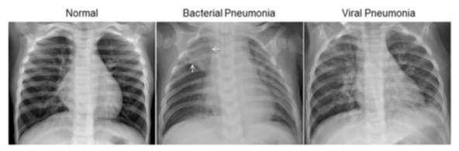

Slide 5
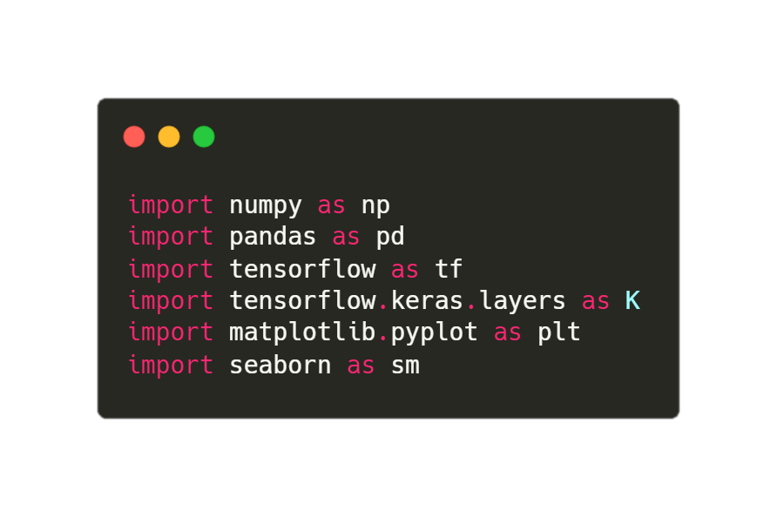
Libraries

Slide 6
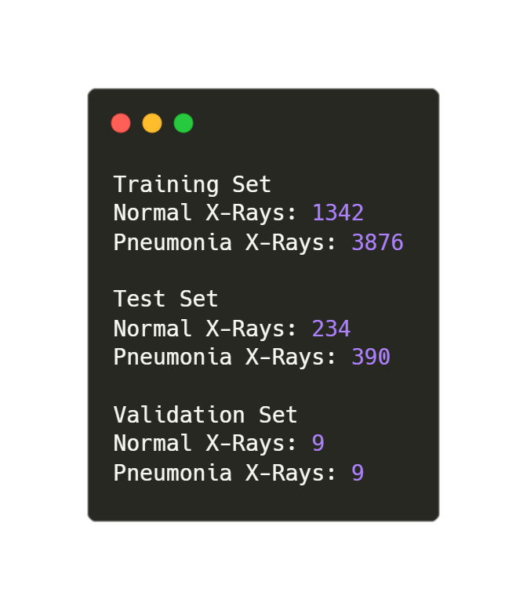
Number of clean images

Slide 7
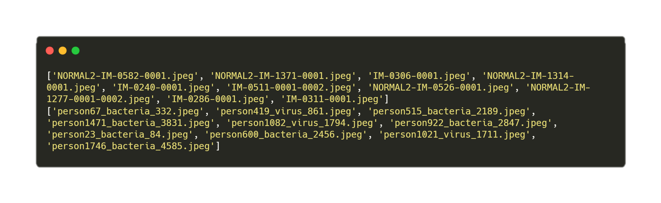
Image Name Samples

Slide 8
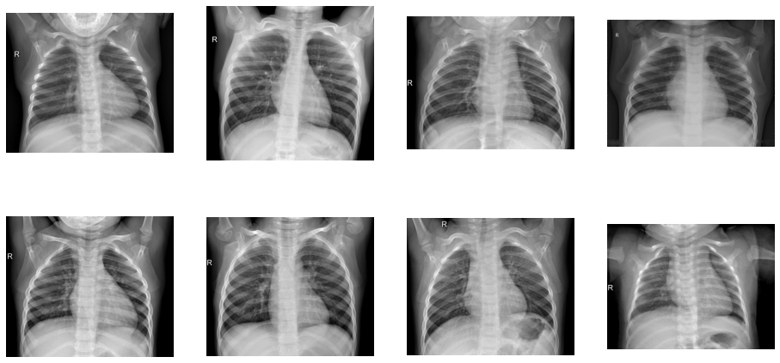
Normal X-Ray Samples

Slide 9
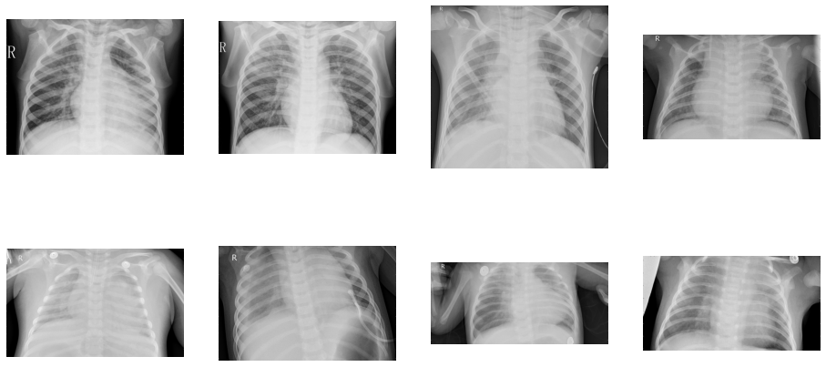
Pneumonia X-Ray Samples

Slide 10
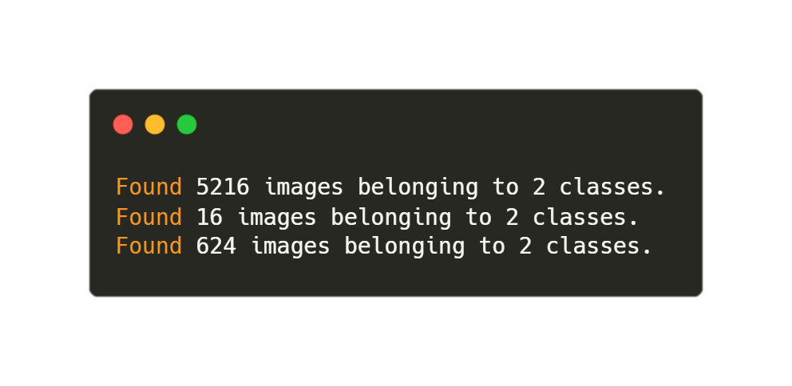
Preparing Generator To Feed Model

Slide 11
Thank You
Harshit Gupta

